Slide 1



UNIT 4: So much to do, so little time
Clubs

Slide 2
Have you joined a club or a free time activity at school?
Which one?
What do you do there?
Where does it take place?
Which teacher leads the activity?
Why do you like?

Slide 3
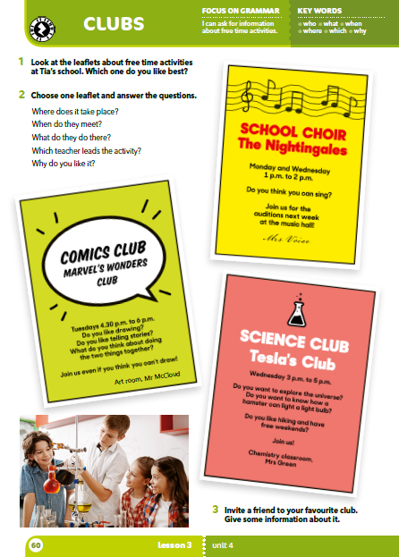



Slide 4

When do they meet?
Where does it take place?
PRACTISE: https://www.bookwidgets.com/play/t:Zu5/Go4QnMRXLwB9scU7q5gpUvijGLspdYqIQxDS9KlQRUszUDk=
What do they do there?
Which teacher leads the activity?
Why do you like it?

Slide 5
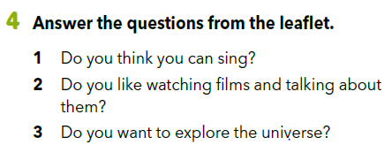
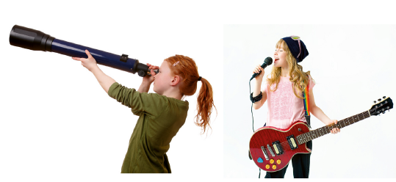
Why? Why not?

Slide 6
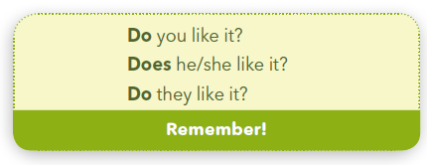
Look at the examples.
Kada koristimo „Does”, a kad „Do” u pitanjima?
„Does” koristimo kad postavljamo pitanja s „he”, „she” ili „it”. „Do” koristimo kad postavljamo pitanja s „I”, „you”, „we” ili „they”.

Slide 7
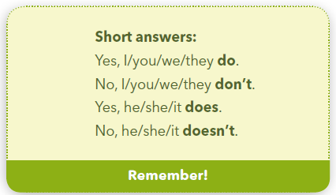
Na pitanja možemo odgovoriti kratkim odgovorima.
Do you like it?
Does he/she/it like it?
Yes, I do.
/ Yes, you do.
/ Yes, we do.
/ Yes, they do.
No, I don’t.
/ No, you don’t.
/ No, we don’t.
/ No, they don’t.
Yes, he does.
/ Yes, she does.
/ Yes, it does.
No, he doesn’t.
/ No, she doesn’t.
/ No, it doesn’t.

Slide 8
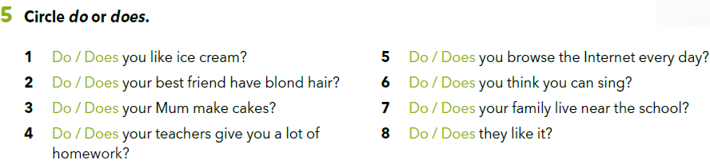
Circle the correct word, do or does.

Slide 9
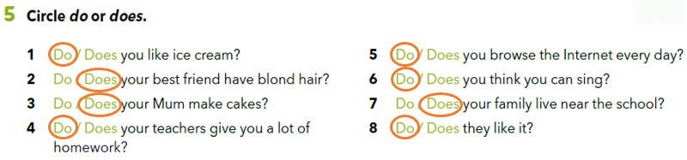


Slide 10
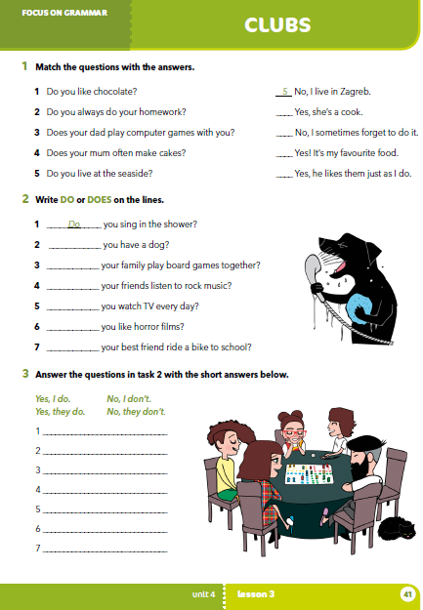
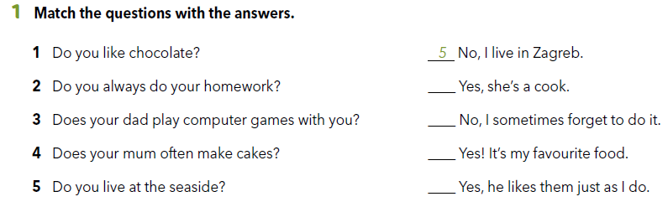
Workbook p 41.
4
2
1
3

Slide 11
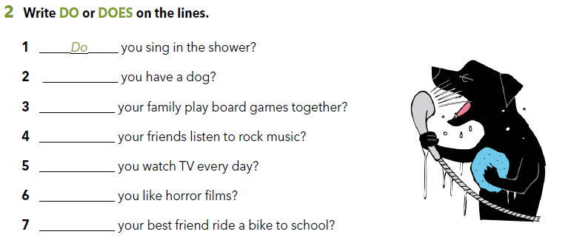
Do
Does
Do
Do
Do
Does

Slide 12
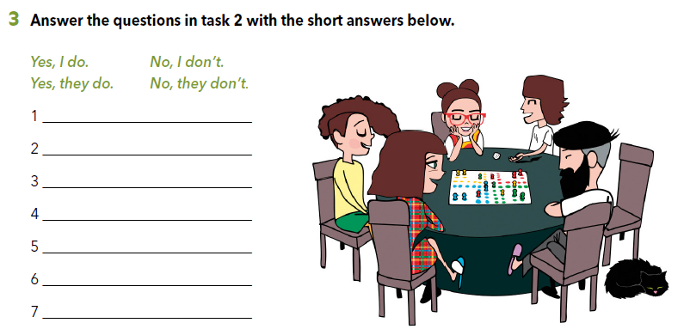

Slide 13

SELF CHECK
https://www.e-sfera.hr/dodatni-digitalni-sadrzaji/d88b7bc1-daec-47ec-a9c6-69aa17492650/

